Slide 1
FINANCIAL RISK DETECTION
GAYATHRI
DW74

Slide 2
PROBLEM STATEMENT
To uses data analysis and machine learning techniques for helping a consumer finance company predict whether someone applying for a loan is likely to have difficulties repaying it.

Slide 3
TOOLS USED:
Visual studio code
Python libraries
Pandas
Seaborn
Matplotlib
Plotly
Sklearn

Slide 4
APPROACH:
Data collection
Data cleaning
Checking for null values and removing
Filling out NaN in columns with scripting
Removing unwanted columns for prediction
Checking for outliers
In this case not removing them because it involves specific information about individuals.
Exploratory data analysis(EDA)
Model building
Classification modeling
Identifying best accurate model
Saving the predictions as pickle file for deployment.

Slide 5
Exploratory data analysis(EDA)

Slide 6
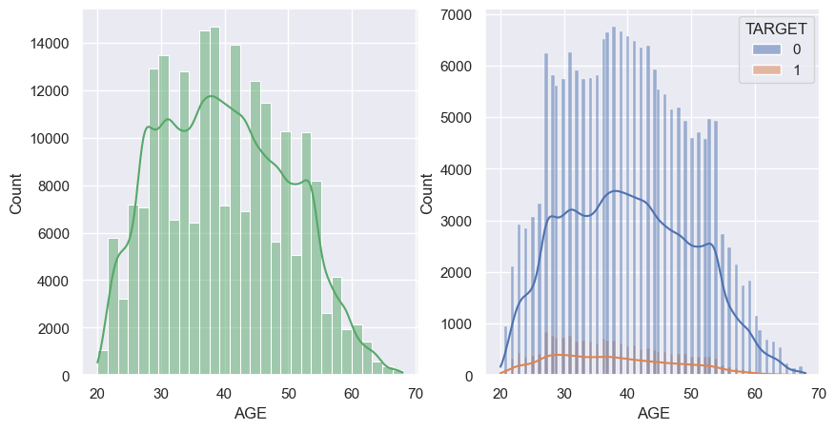
Clients' ages range from 20 to 70. Among those with a target value of 0, the count falls within the range of 1 to 900.

Slide 7
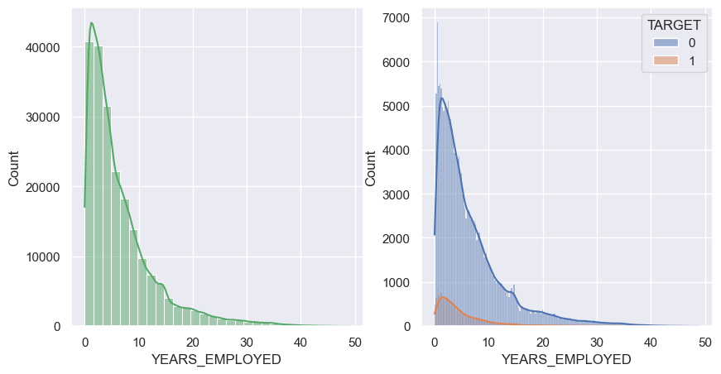
Clients' employment years range from 0 to 50. Among those with a target value of 1, clients are in the employment year range of 0 to 25, and their counts range from 1 to 800.

Slide 8
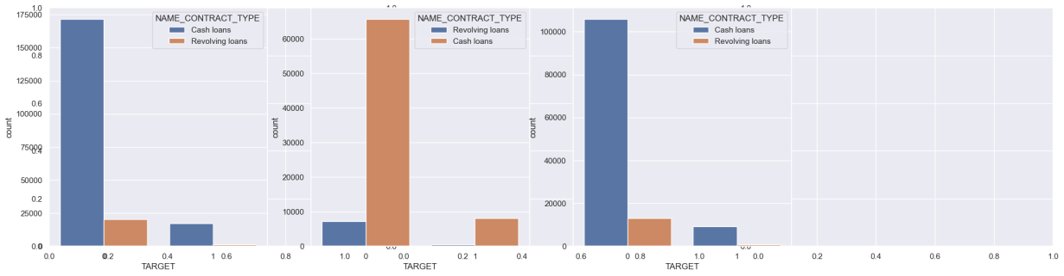
- 1.The count of clients with secondary and secondary special education levels is higher, indicating that they receive more loans regardless of gender. The second highest group receiving loans consists of clients with higher education.
- 2.Specifically, 55,000 males and 80,000 females with secondary and secondary special education levels have received loans. Moreover, regardless of gender, a larger number of clients categorized as non-defaulters (0) are observed.
v

Slide 9
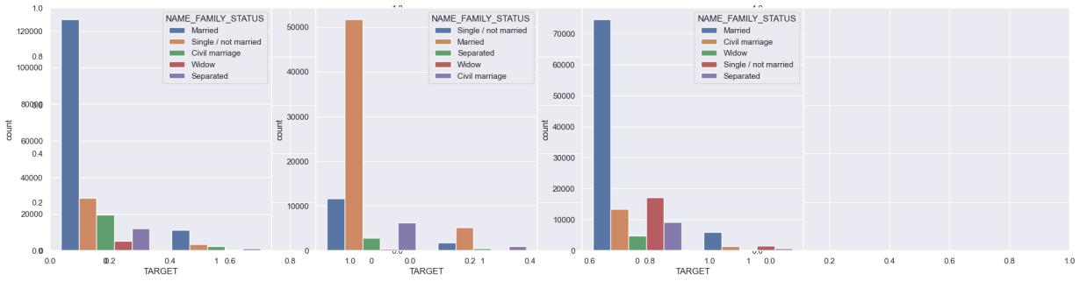
Married clients tend to obtain more cash loans

Slide 10
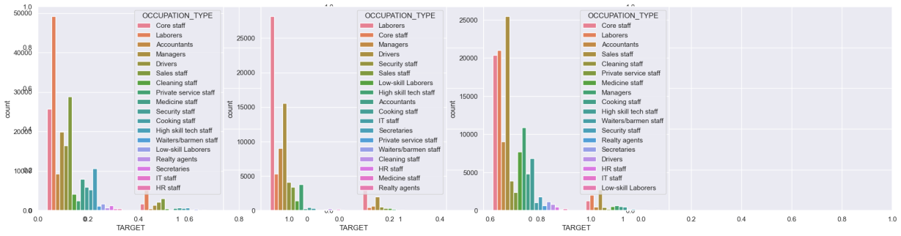
Overall, 40,000 individuals working as laborers have obtained more loans. Among them, 27,000 are male laborers. In terms of females, those working as sales staff have received the highest number of loans, totaling 25,000 clients.

Slide 11
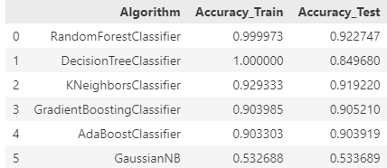
Random Forest Classifier performs best with good accuracy

Slide 12
THANK YOU!!!

